Slide 1

Research on Apache
Mrunal Kiran
Data warehousing (ITMD-526)

Slide 2
cONTENT
What is Apache Iceberg?
Competitors: Then vs Now
Key Competitors Overview
Why Choose Apache Iceberg?
Demo and Visualizations

Slide 3
What is Apache Iceberg?
•⁠ ⁠Open table format for large analytic datasets
• ACID transactions, schema evolution & time travel
• Optimized metadata with hidden partitioning
• Compatible with Spark, Flink, Trino, and more

Slide 4
Competitors: Then vs Now
In 2018:
------ Apache Hive
------ Presto
------ Hudi
Now:
------ Delta Lake
------ Apache Hudi
------ AWS lake formation

Slide 5
Key Competitors
Delta Lake: Databricks‑built, strong Spark integration
Apache Hudi: Facebook‑origin, incremental ingestion focus
AWS Lake Formation: AWS‑managed data lake service

Slide 6
Why Choose Apache Iceberg?
Vendor‑neutral, open‑source format
High‑performance with metadata pruning
Full ACID support & rollback capabilities
Seamless schema evolution & time travel
Broad engine and cloud compatibility

Slide 7
DEMO OUTLINE
⁠Configure spark‑shell with Iceberg settings
Create namespace & table in Iceberg
Load and query synthetic data
Use time travel and inspect snapshots
Export aggregated data for visualization

Slide 8
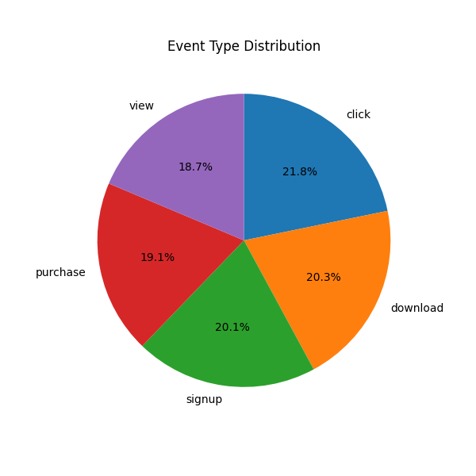
eVENT type distribution
Question: What share of our total events does each event type represent?
The slice size for each event_type (click, download, signup, purchase, view) shows its percentage of the overall 5 000 events.

Slide 9
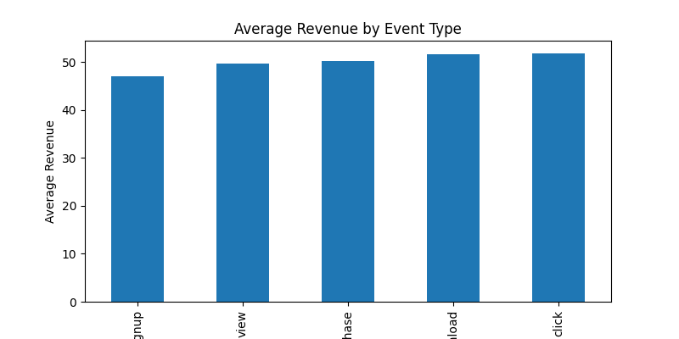
Average revenue by event type
Question: Which event types generate the highest average revenue per event?
For each event_type, the average of the revenue field (in dollars).

Slide 10
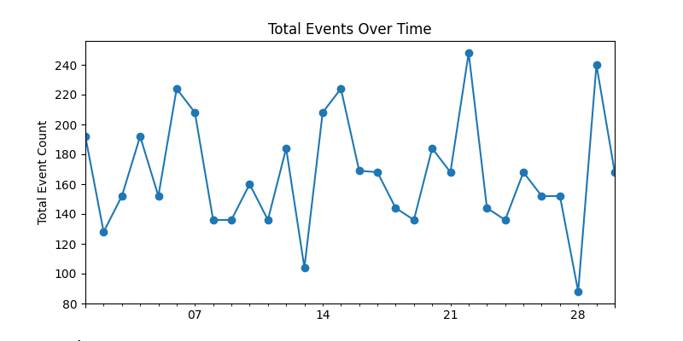
Total events over time
How does overall event volume change day‑to‑day over the month?
Daily sum of all events (cnt) against event_date.

Slide 11
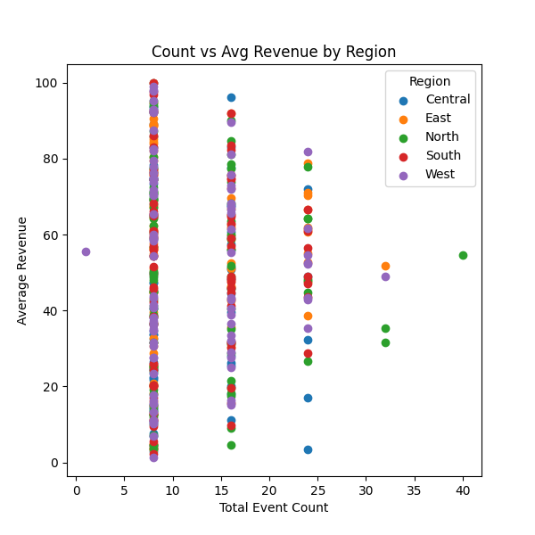
Count vs average revenue by region
Across regions, is there a relationship between event volume and per‑event revenue?
Each point is a (cnt, avg_revenue) pair for one region & event_type combination; color = region.

